Slide 1
Hub
Actions
Store
dispatcher$

Slide 2
Action: FETCH_TODOS_SUCCESS
fetchTodosEffect$
replay of action sent to effect
Store
dispatcher$
Action: FETCH_TODOS

Slide 3
fetchTodosEffect$
Store
id: 2
id: 1
dispatcher$
Action: UPDATE_TODO
{ id: 1 }
id: 1
updateTodoEffect${ id: 1}
id: 1
id: 2
Action: UPDATE_TODOS_SUCCESS
{ id: 1 }
Action: UPDATE_TODO
{ id: 2 }
updateTodoEffect$
{ id: 2 }
id: 2
Action: UPDATE_TODOS_SUCCESS
{ id: 2 }
Scoped Effects

Slide 4
Hub
Store
Hub
Store
Store
Store
Store
Hub
Store
Store
Store
Hub
Store
Hub
Store
Hub
Store
Hub
Store

Slide 5
App
Hub
Store
Component
Hub
Store
Store
Component
Store
Store
Hub
Component
Component
Component
Store
Store
Store
Hub
Store
Component
Component
Component
Hub
Store
Hub
Store
Hub
Store

Slide 6
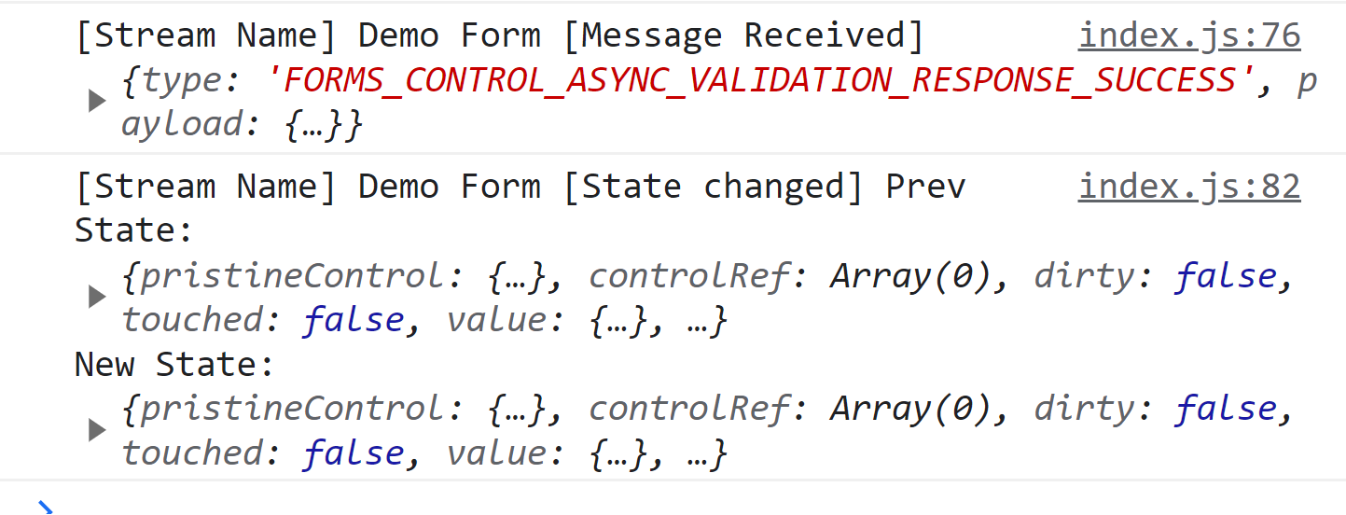

Slide 7
id: 2
id: 1
Store
id: 1
id: 1
id: 2
id: 2

Slide 8
App
Hub
Store
Component
Hub
Store
Store
Component
Store
Store
Hub
Component
Component
Component
Store
Store
Store
Hub
Store
Component
Component
Component
Hub
Store
Hub
Store
Hub
Store

Slide 9
??? What to use ???
Frontend Framework | Application (global) State | Component (local) state
React | Redux Context API | useState useReducer
Angular | NgRx Angular Services | Signals RxJS Observables Component class properties
Vue | Pinia Reactivity API Vuex | ref
Frontend Framework | Application (global) State | Component (local) state
React | Reactables
Angular
Vue

Slide 10
Reactable Forms
View
Hub 1 – User Actions
User Input
Hub 2 – Async Validation
Base Form Store
(partial validation)
controlAsyncValidator$
Validated Form Store
dispatcher$
sourceForHub2$
controlAsyncValidator$
Dispatcher (User) Actions
FORMS_CONTROL_CHANGE
FORMS_ADD_CONTROL
Source For Hub 2 Actions
FORMS_FORM_CHANGE
FORMS_ASYNC_VALIDATE_CONTROL
FORMS_ASYNC_VALIDATE_SUCCESS_RESPONSE

Slide 11
Basic Counter Example
Store
dispatcher$
RESET
INCREMENT

Slide 12
Scoped Effects Example – Todo Status Updates
updateTodoEffect$
{ id: 2 }
id: 2
id: 2
Store
id: 2
id: 1
dispatcher$
id: 1
updateTodoEffect${ id: 1}
id: 1
Scoped Effects
ACTIONS:
SEND_TODO_STATUS_UPDATE
TODO_STATUS_UPDATE_SUCCESS

Slide 13
Connecting Multiple Hubs Example – Event Prices
Hub 1 – User Controls
Event Selection
Ticket Quantity
Event Tickets
Select Event
Hub 2 – Fetch Price for Event
Choose Quantity
Store for User Controls State
getPriceEffect$
Store Event Tickets State
dispatcher$
sourceForHub2$
Dispatcher (User) Actions
SELECT_EVENT
SET_QTY
Price: $100
Source For Hub 2 Actions
CONTROL_CHANGE
FETCH_PRICE SUCCESS

